Slide 1
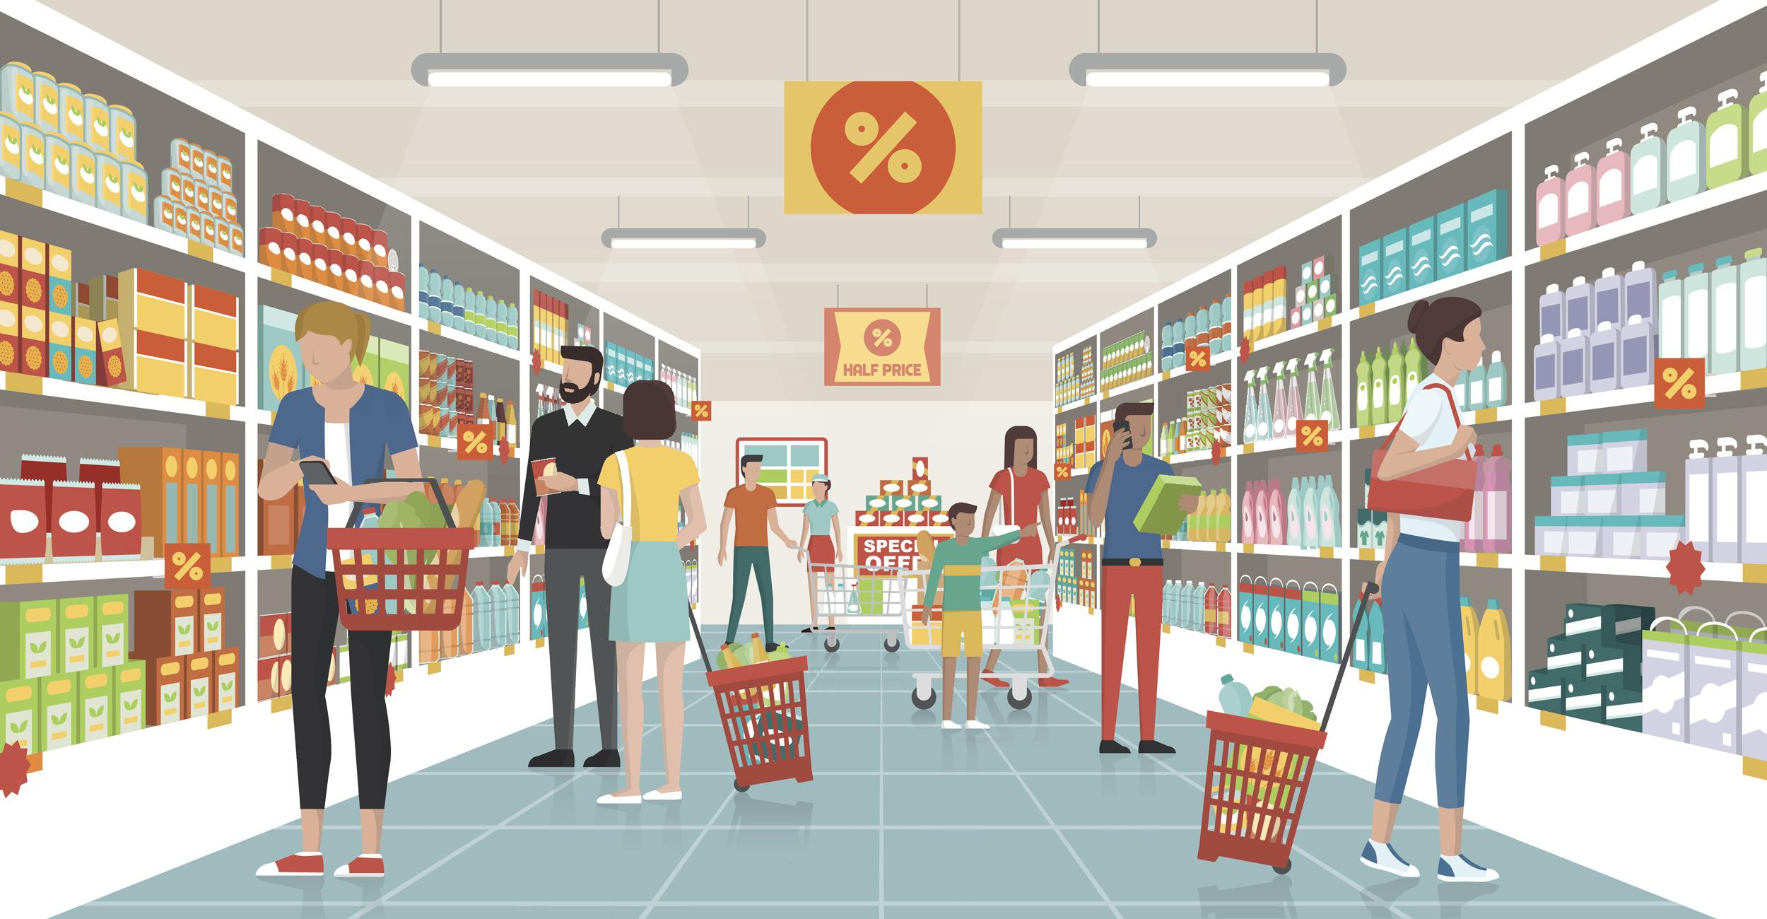
Grocery Shopping
http://www.pisoandbeyond.com/2014/09/8-sari-sari-store-designs-and-concepts.html
Developed by:
Charlette Cunanan, B.Sc. (Nutrition), B.Ed. [2022]

Slide 2

01
02
03
04
Go through these slides and fill out the notes. You will have instructions along the way.
Click on a box to take you to that section.
SHOPPING LISTS
SHOPPING MATH
MONEY SAVING TIPS
THE STORES

Slide 3
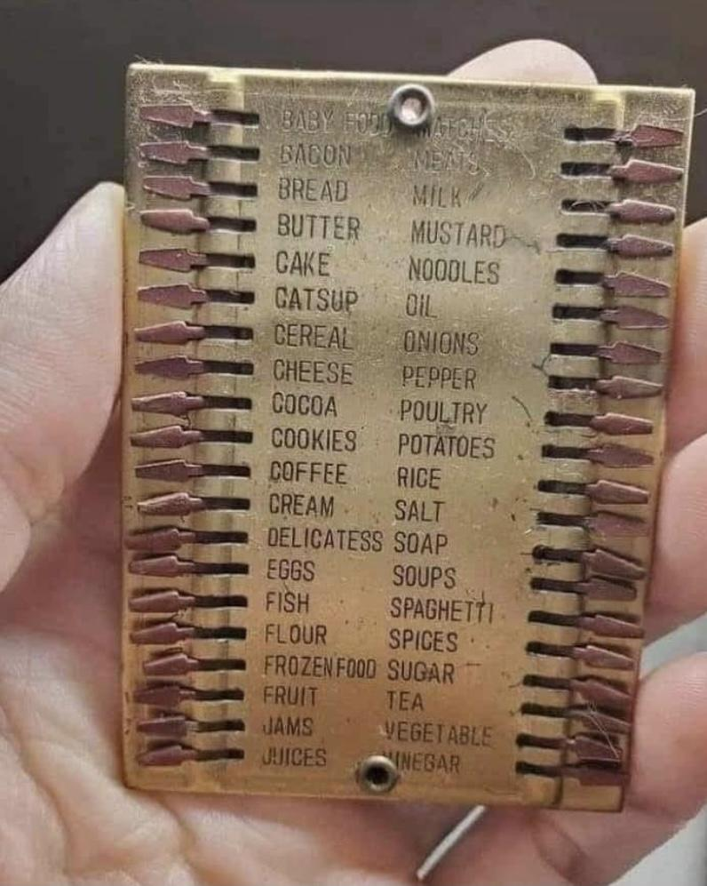
Grocery Lists
Check what you have at home and what is close to being done
  ^{Pantry}
  ^{Fridge}
  ^{Laundry}
You can use up items and finish them in leftover meals
Next Slide
http://www.pisoandbeyond.com/2014/09/8-sari-sari-store-designs-and-concepts.html

Slide 4
Things to consider when making a shopping list
Click Here for
Click here for
Leftover Tips
Staple Foods
Home

Slide 5
Staple Foods
When you have all the basic cooking supplies on hand, you can be ready to prepare a meal on short notice and without the time and expense of running to the store for ingredients.
Some families may not be able to live without hot sauce, while others add soy sauce to everything. If you have a family member who is allergic to peanuts, then obviously you can scratch the peanut butter from your list.
List of Staple Foods

Slide 6
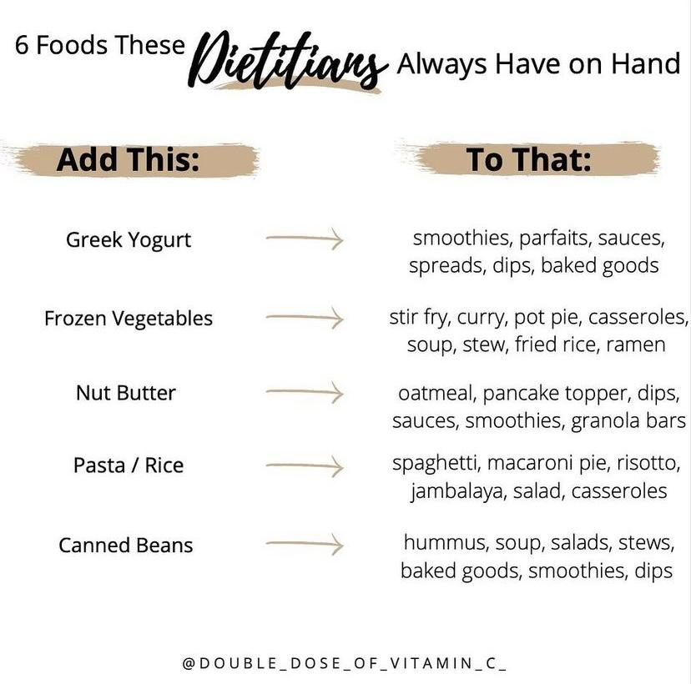
Staple Food Examples
Salt
Sugar
Flour
Rice
Pasta
Canned Goods
Oils
Spices
Sriracha
Honey
Dried fruits
Shopping Lists

Slide 7
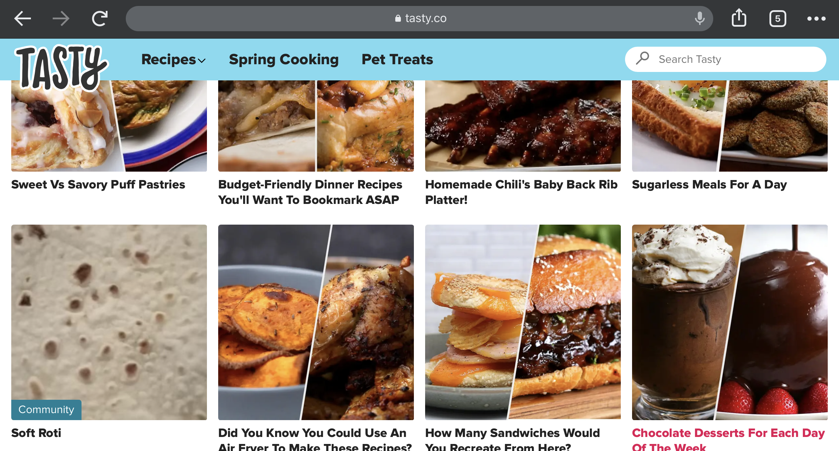
Leftover Meals
Use everything possible. Got a bunch of leftover ingredients (half an onion, a bit of tomato, some pasta, a few other veggies?) … combine them for a quick meal, so that these don’t go to waste before your next grocery trip.
The more you can stretch the food, and the less you waste, the less you’ll spend in the long run.
Scrap Cooking

Slide 8
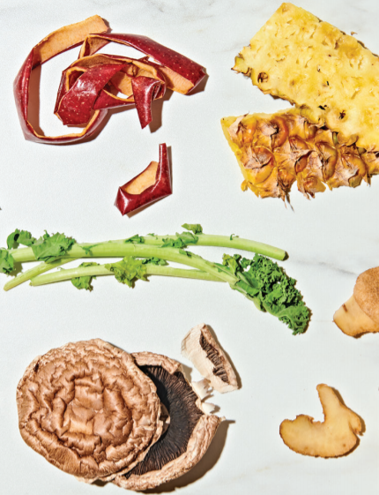
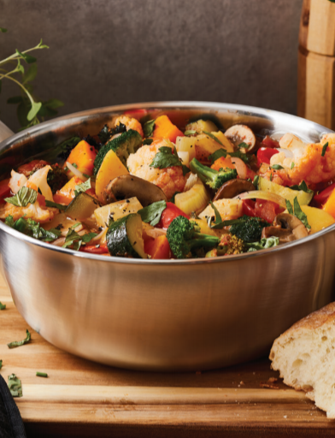
Scrap Cooking - Using leftovers!
If you want to use up the rest of your leftover foods… you could make
Soup
Sides
Salads
Omelettes
Pizza
Stir Fry
Sandwiches
Shopping Lists

Slide 9
Grocery Shopping Math
Unit Price
Sale Items
Coupons
Home

Slide 10
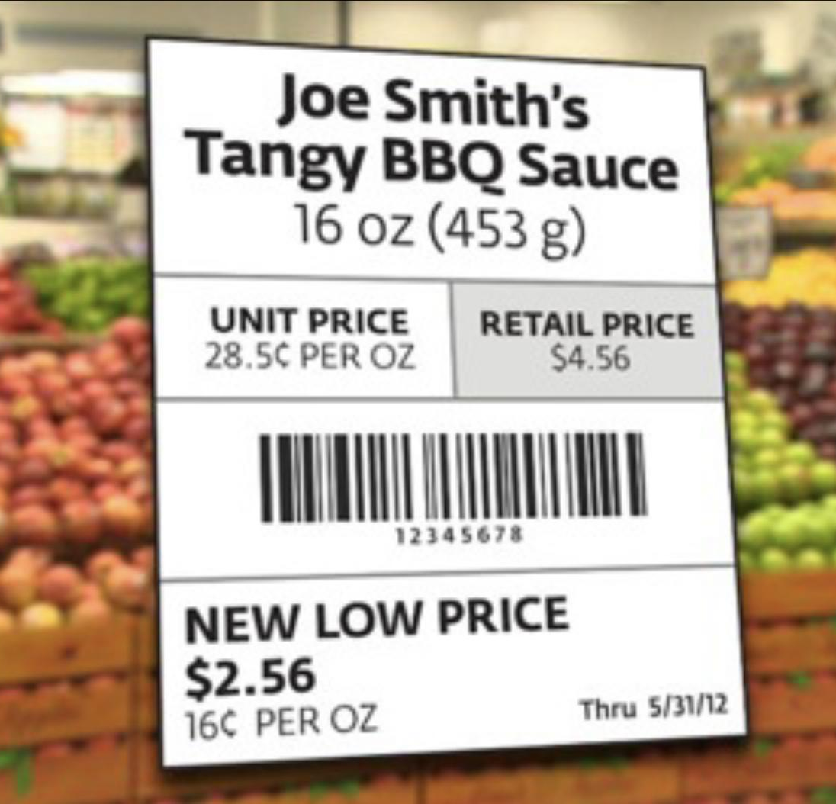
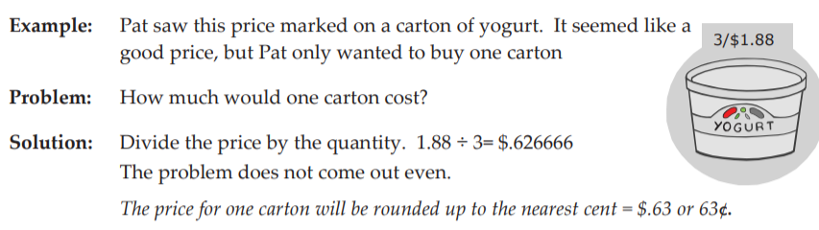
Unit Pricing
To find the unit price of an item, first take the price listed and divide it by the quantity
https://www.fess.ie/images/stories/ResourcesForTutors/KitchenMathWrkbk.pdf
Shopping Math

Slide 11
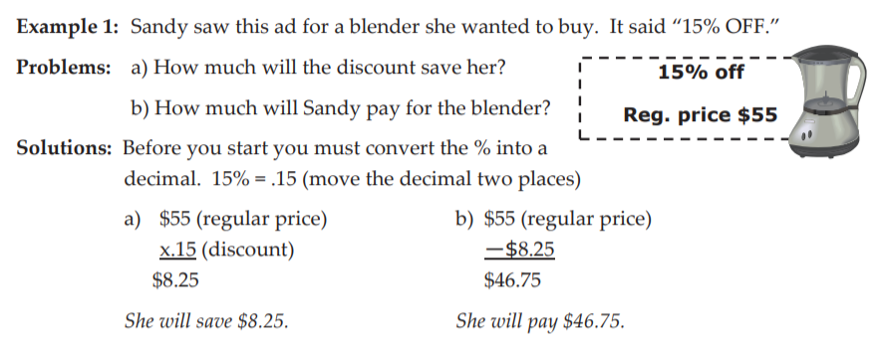
SALE ITEMS
https://www.fess.ie/images/stories/ResourcesForTutors/KitchenMathWrkbk.pdf
Shopping Math

Slide 12
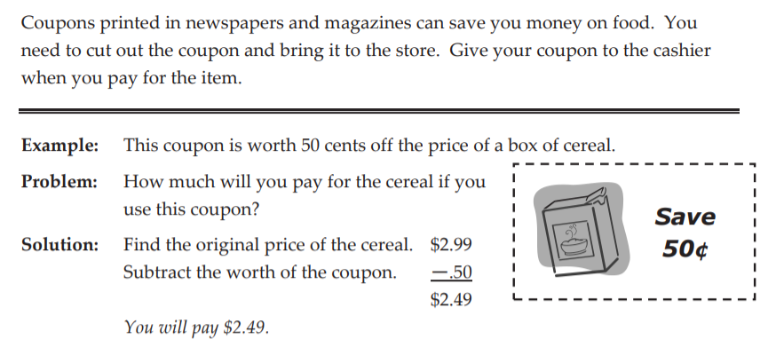
COUPONS
https://www.fess.ie/images/stories/ResourcesForTutors/KitchenMathWrkbk.pdf
Shopping Math

Slide 13
More Money Saving Tips
FRESH PRODUCE
&
FROZEN PRODUCE
NON-PERISHABLES
& BUYING IN BULK
MEATS
BUY WHAT YOU CAN PROPERLY STORE
Home

Slide 14
In Season
Produce typically costs less when it’s in season.
When a certain type of produce is being harvested in abundance, grocers usually lower prices due to the increased local supply.
On the other hand, fruits and veggies cost more when they aren’t in season because they have to be shipped from distant farms where growing conditions are more ideal. The cost to transport out-of-season produce is passed onto the consumer.
What’s in Season
Frozen Produce

Slide 15
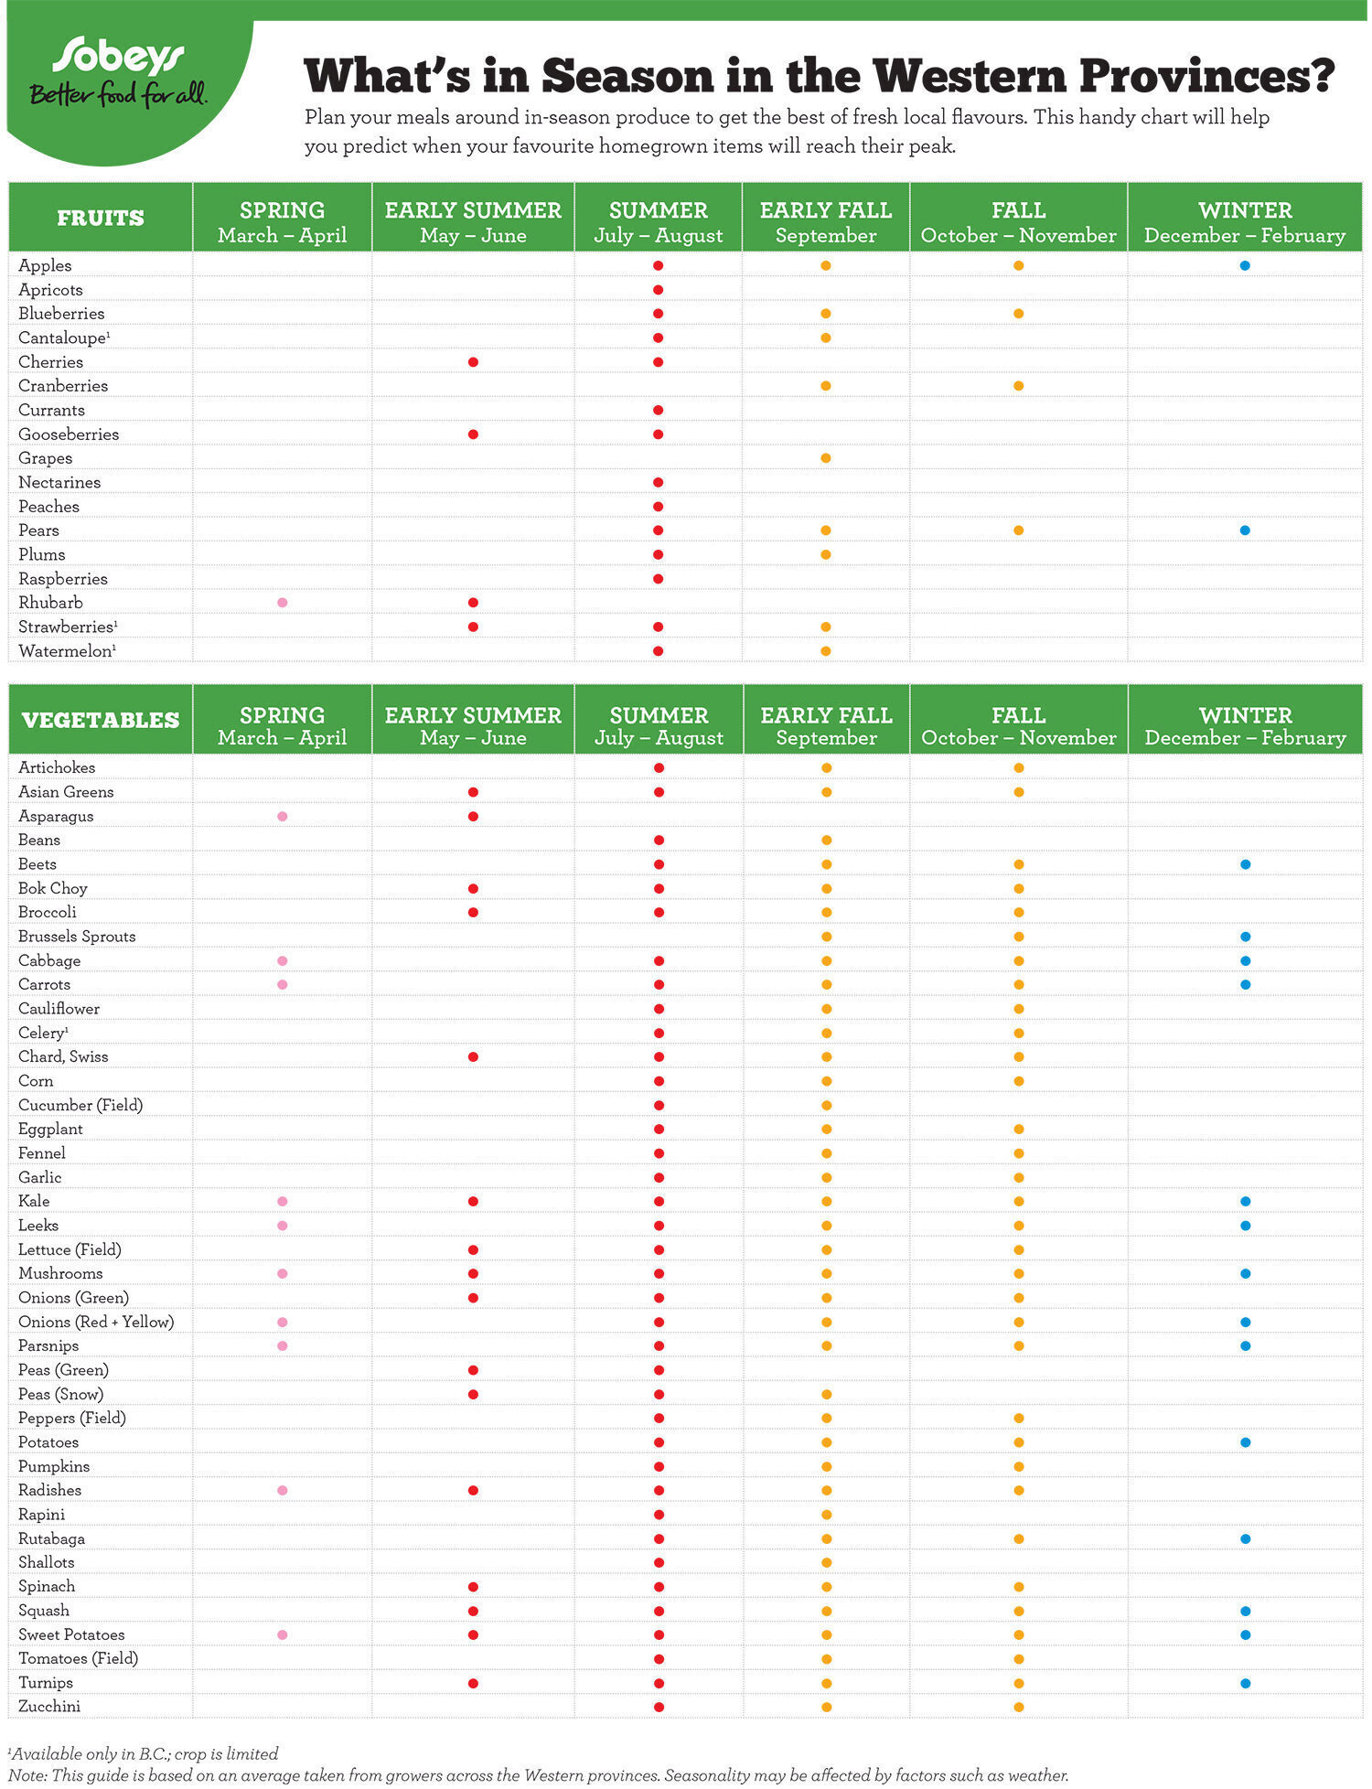
Saving money on Produce
Frozen Produce
Back to Saving Tips
https://www.sobeys.com/en/articles/whats-season-guide-canadian-produce-west/

Slide 16
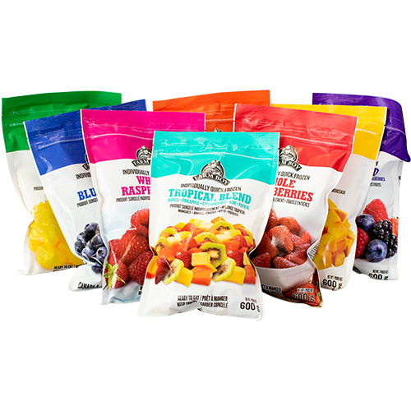
Saving money on Frozen Produce
Frozen fruits and vegetables are harvested at the peak of ripeness and then quickly frozen to lock in nutrients.
One of the benefits of frozen food is that it doesn’t have to be in season, so you can still be eating summer berries in the middle of winter.
What’s in Season
Back to Saving Tips

Slide 17
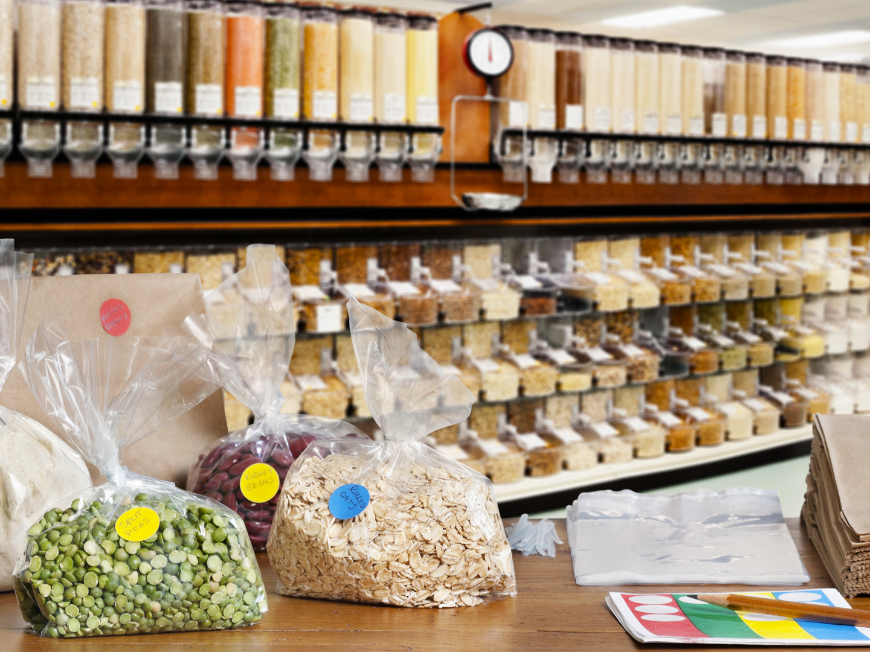
Saving money on Non-Perishables & Bulk Buying
The cost per unit of an item is usually cheaper when buying in bulk.
You don’t want to buy in bulk just to end up with the “bulk” of it in the trash. Stick to buying things you know you or your family will eat.
Another benefit of bulk buying is less packaging and therefore less plastic waste.
flour
grains
rice
pasta
dried beans
Nuts & seeds
nut butters
dried fruit
sweeteners
Back to Saving Tips

Slide 18
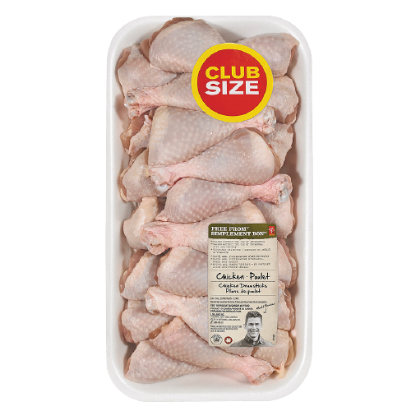
Saving Money on Meat
When there's a great sale, buy a whole lot and freeze.
Buying the whole animal and breaking it down at home will save you money.
There are many cuts of meat, some more expensive than others: Tenderloin, rib eye, strip, prime rib and ground.
Try skirt, flank, shank, shoulder, cheek or tail. These cuts are flavourful, tend to be better marbled and are often more inexpensive.
Back to Saving Tips

Slide 19
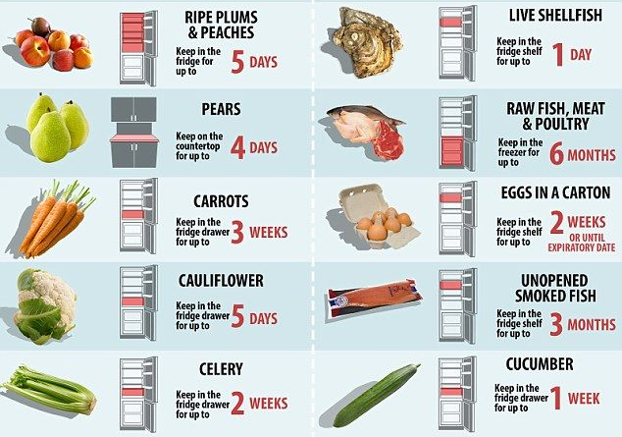
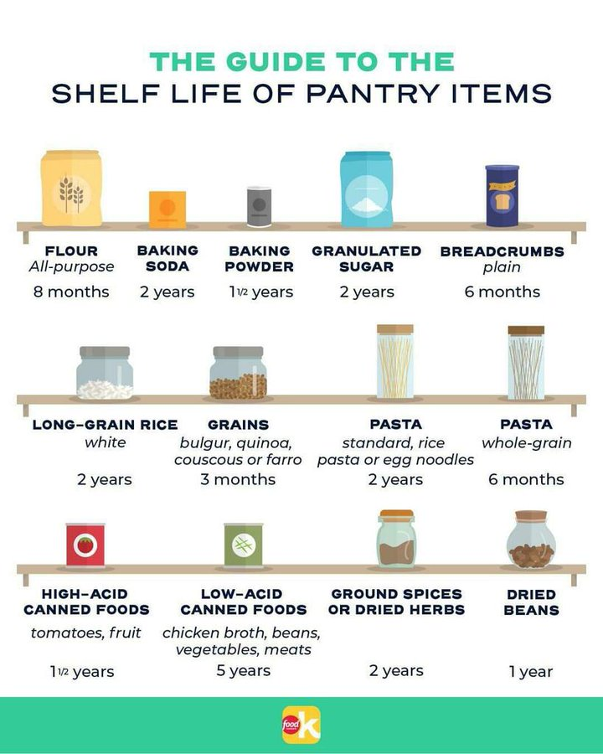
Buy what you can properly store
Back to Saving Tips
https://www.dailymail.co.uk/femail/food/article-3060400/How-store-food-properly-doesn-t-off.html?utm_content=buffer6c652&amp=&utm_medium=social&amp=&utm_source=pinterest.com&amp=&utm_campaign=buffer
Food Network Kitchen, Instagram

Slide 20
STORES
Brands
Loyalty Programs
Marketing
Home

Slide 21
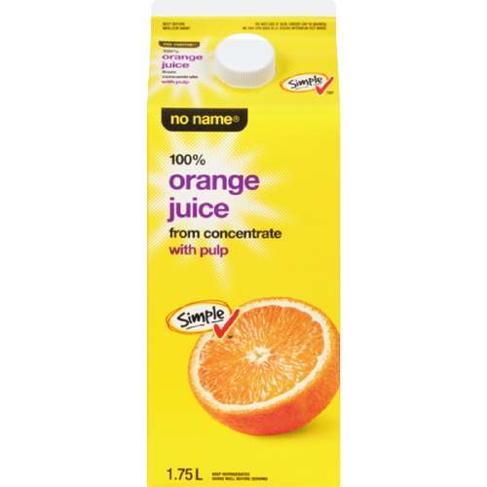
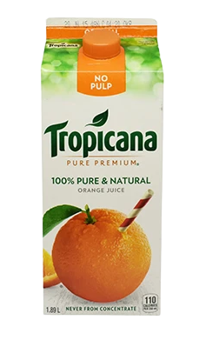
Store vs. Name Brands
Store brands are usually less expensive and often are the same quality
Check the unit price to compare
Stores

Slide 22
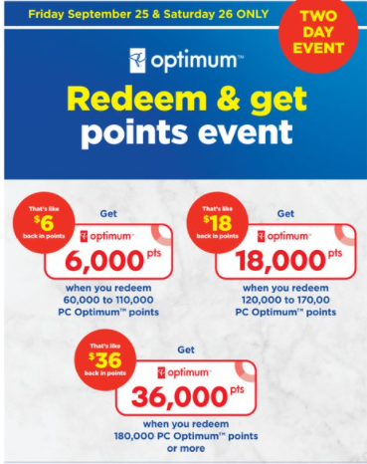
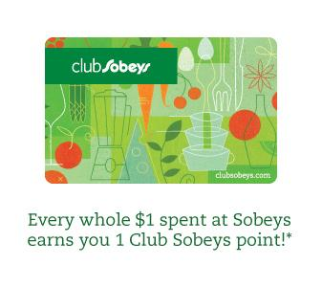

Loyalty Programs
While you shop you can earn points. With a certain number of points, you can redeem a certain amount of money on your groceries!
Stores

Slide 23

Marketing
Stores

