Slide 1
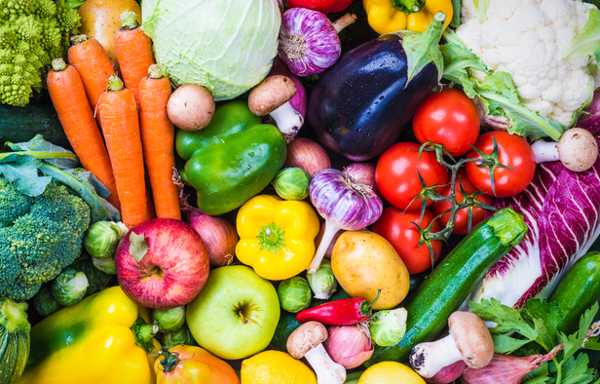
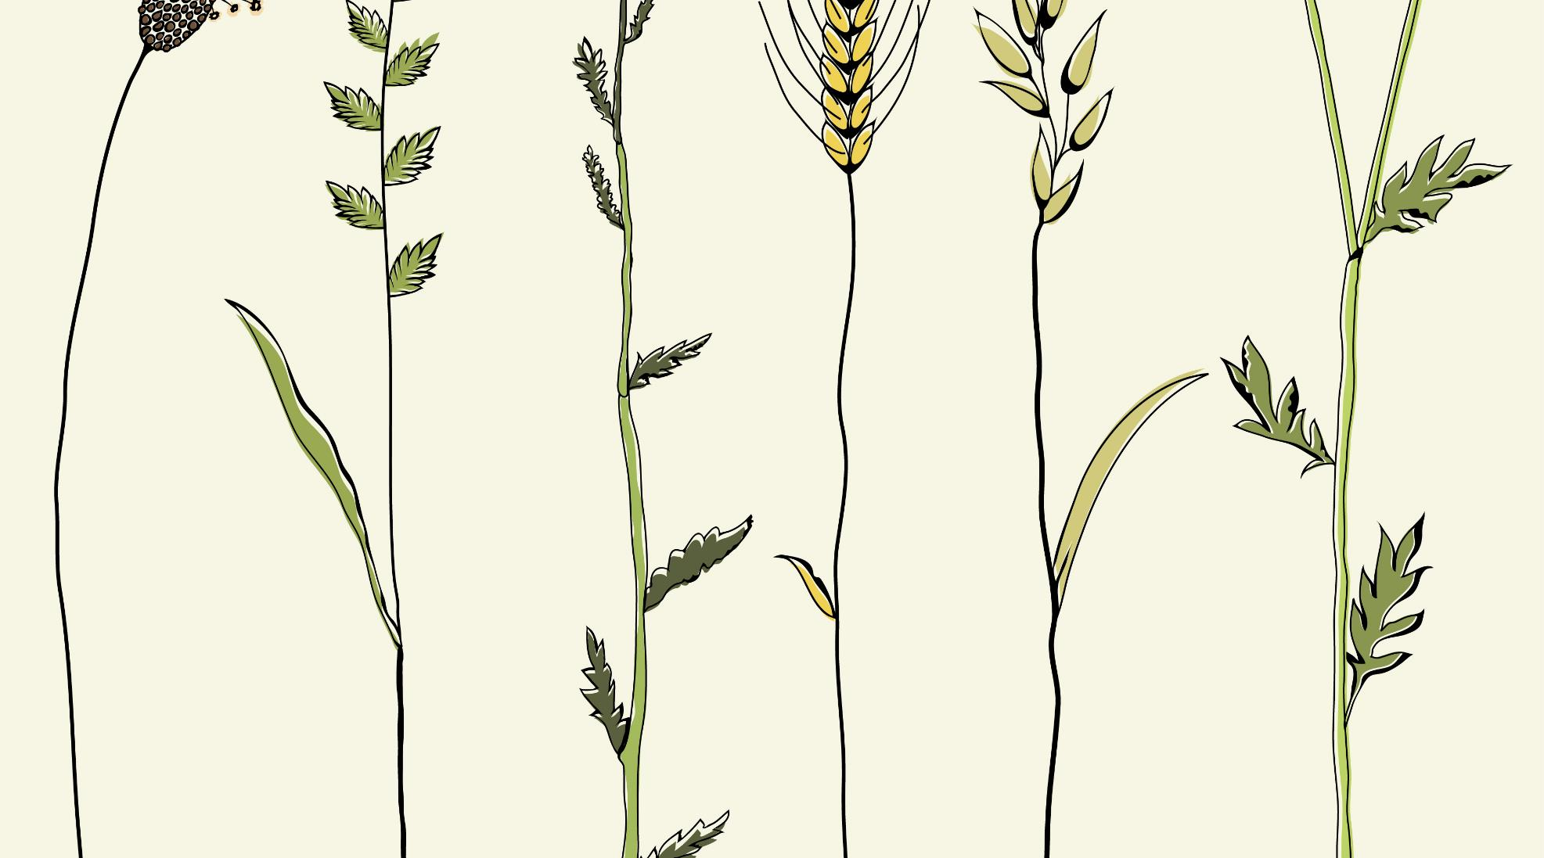
Introduction to Food Security
Developed by: Jacintha Antonio, B.Sc. (Human Nutritional Sciences), B.Ed. [2024]

Slide 2
What is “food security”?

Slide 3
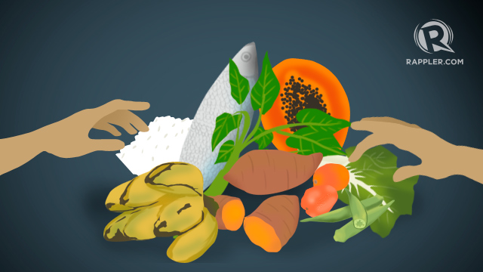
Food Security:
“Food security exists when all people, at all times, have physical and economic access to sufficient, safe and nutritious food to meet their dietary needs and food preferences for an active and healthy life.”
-Food and Agricultural Organization of the United Nations (2010)
Photo source: https://www.rappler.com/moveph/51726-food-security-philippines/
3

Slide 4
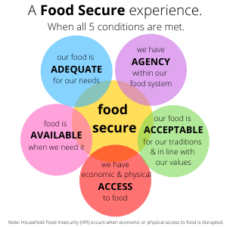
Available: There is always enough food for all people Adequate: All people can have nutritious food that meets their physical, emotional, and spiritual needs Acceptable: All food is produced and consumed in culturally-appropriate, sustainable, and dignified ways Accessibility: All people can eat well, free from physical, economic, social, or political barriers Agency: All people understand, benefit from, and can make changes to the food system.
The 5 A’s of Food Security:
Photo: https://foodmattersmanitoba.ca/food-security/
https://www.ryerson.ca/foodsecurity/

Slide 5
What is food insecurity?

Slide 6
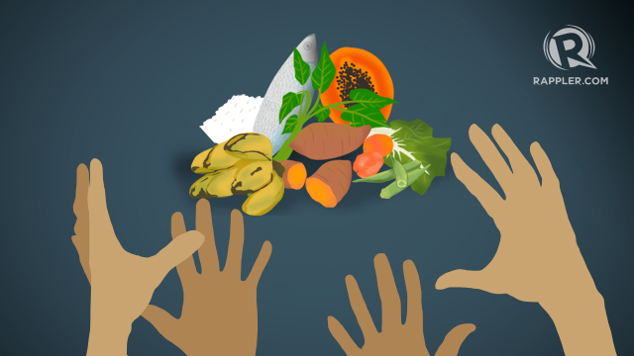
Food Insecurity
Is the opposite of food security
Food insecurity: not being able to get enough food or enough healthy foods that you like and enjoy on a regular basis
Can mean wondering or worrying about where your next meal will come from
Factors that threaten food security (and lead to food insecurity) include:
Poverty – main/root cause
Access to fresh produce
Distance to grocery stores
Food deserts
Inability to prepare food (lack of food skills)
Nutrition awareness
Photo souce:
https://www.rappler.com/moveph/51726-food-security-philippines/

Slide 7
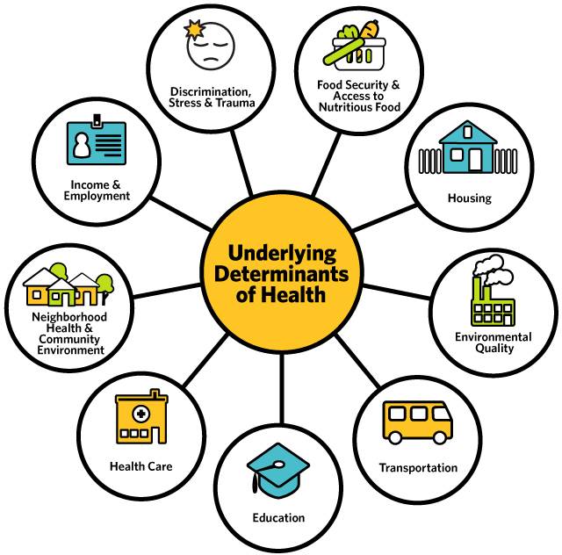
Food Security: One of the Social Determinants of Health
When people do not have one or many of these “determinants” in their lives, they are at risk of being unhealthy
Food Security is one of the Social Determinants of Health
Food insecurity may prevent individuals from maintaining good health by affecting the quality and quantity of their food intake.
Source: https://mffh.org/news/many-factors-lead-lifelong-health/

Slide 8
Household Food Security
1 in 8 households in Canada is food insecure, amounting to over 4 million Canadians, including 1.15 million children, living in homes that struggle to put food on the table
1 in 6 Canadian children under the age of 18 is affected by household food insecurity
Household Food Insecurity disproportionally impacts Indigenous people, people of colour, single mothers, those on social assistance, and those with low-paid work
Members of food-insecure households may:
Be forced to skip meals
Be unable to afford balanced meals
Eat less than one thinks they should because they’re afraid of running out of food
Lose weight because there wasn’t enough money for food
Sources: https://proof.utoronto.ca/food-insecurity/
Notes:
Food insecurity is a big problem in Canada.

Slide 9
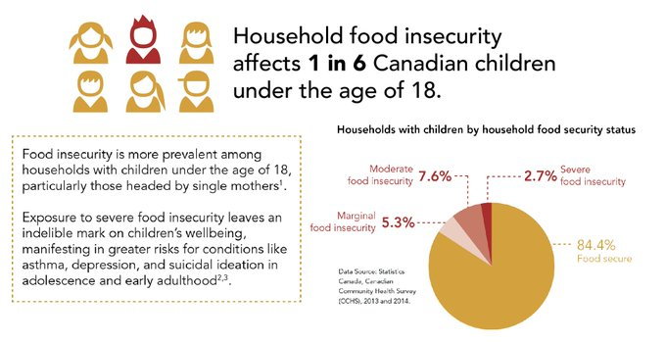
Household Food Security
Adults and adolescents in food-insecure households in Canada are more likely to experience nutrient inadequacies and have poorer diets, with lower intakes of milk products, fruits, and vegetables compared to people who are food secure
Food insecurity leaves a permanent mark on children’s wellbeing.
There is a strong relationship between food insecurity and poor mental health
Experiencing food insecurity at an early age is associated with childhood mental health problems, such as hyperactivity and inattention.
Experiences of hunger in childhood increase the risk of developing asthma, depression, and suicidal ideation in adolescence and early adulthood.
Source:: https://proof.utoronto.ca/food-insecurity/

Slide 10
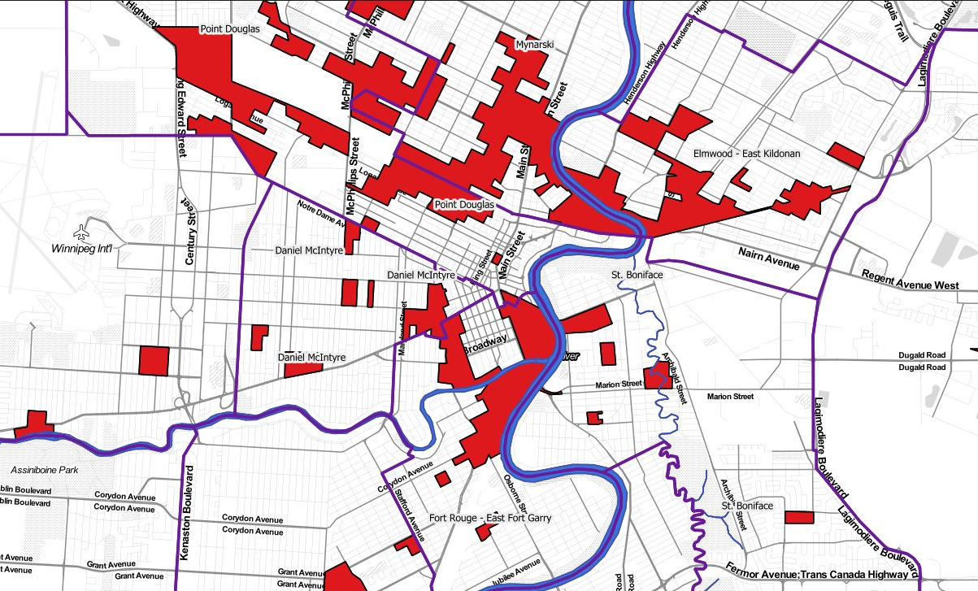
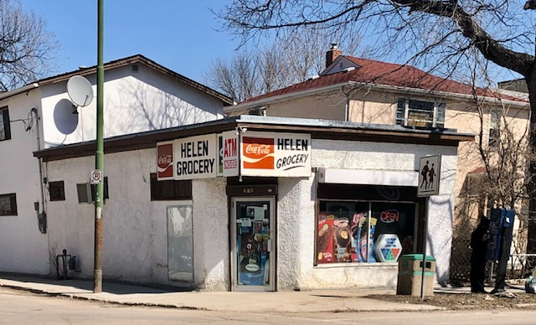
Food Deserts
Residential geographic [areas], typically in urban settings, where low-income residents have limited or no access to [grocery stores] with enough variety at affordable cost
Often defined by:
Household income
Distance from a supermarket
Vehicle ownership
Availability of healthy food in local stores
Sources:
Slater, J., Epp-Koop, S., Jakilzaek, M., Green, C. (2017). Food deserts in Winnipeg, Canada: A novel method for measuring a complex and contested construct. Health Promotion and Chronic Disease Prevention in Canada, 37(10), 350-356. https://doi.org/10.24095/hpcdp.37.10.05
Photo Sources:
https://www.survwpg.ca/MBCDP/FoodAtlas2019/FoodAtlas_Overview_Dec24_19 (top)
J.Antonio, 2020 (bottom)
Notes:
Community Food Security relates to the people in a community’s ability to access enough healthy food.
A food desert is where low-income residents have limited or no access to retail food establishments with enough variety at affordable cost.

Slide 11
Sources
Slide 3:
https://www.rappler.com/moveph/51726-food-security-philippines/
Food and Agricultural Organization of the United Nations (2010)
Slide 4:
https://www.ryerson.ca/foodsecurity/
https://foodmattersmanitoba.ca/food-security/
Slide 6:
https://www.rappler.com/moveph/51726-food-security-philippines/
Slide 7:
https://mffh.org/news/many-factors-lead-lifelong-health/
Slide 8+9:
https://proof.utoronto.ca/food-insecurity/
Slide 10:
Slater, J., Epp-Koop, S., Jakilzaek, M., Green, C. (2017). Food deserts in Winnipeg, Canada: A novel method for measuring a complex and contested construct. Health Promotion and Chronic Disease Prevention in Canada, 37(10), 350-356. https://doi.org/10.24095/hpcdp.37.10.05
J.Antonio, 2020

